Slide 1

Graduate School of Natural And Applied Sciences of Dokuz Eylül University
In Partial Fulfillment of the Requirements for the Degree of Master of Science in
Department of Statistics
AN INVESTIGATION OF FEATURE SELECTION METHODS FOR CLASSIFICATION PURPOSES USING SUPERVISED MACHINE LEARNING
*
Assoc. Prof. İdil YAVUZ
M.Sc. Buse Nur BALTACIOĞLU
github.com/busebaltacioglu/ege7kongre

Slide 2
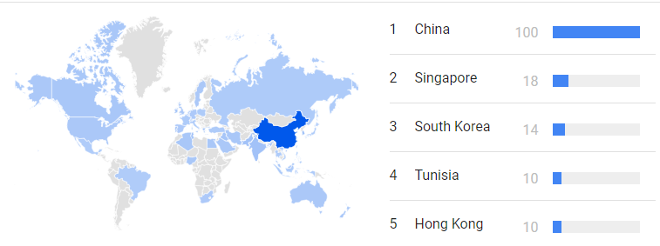
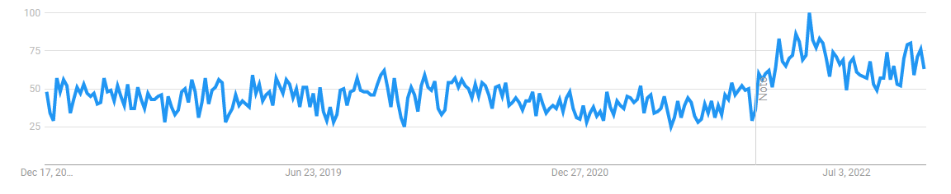
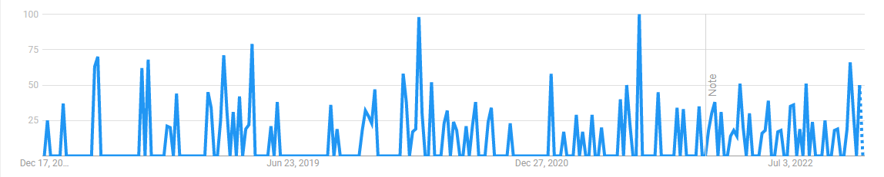
Literature Review
Notes:
With the exponential advancement of technology, topics such as artificial intelligence, machine learning and big data have become popular. In the last 5 years, the most researched countries about feature selection in science, the first one being China, and other countries. Looking at the graphic in the middle, the issue of feature selection around the world has started to attract more attention recently. The rate of research in Turkey is given in the last chart.

Slide 3
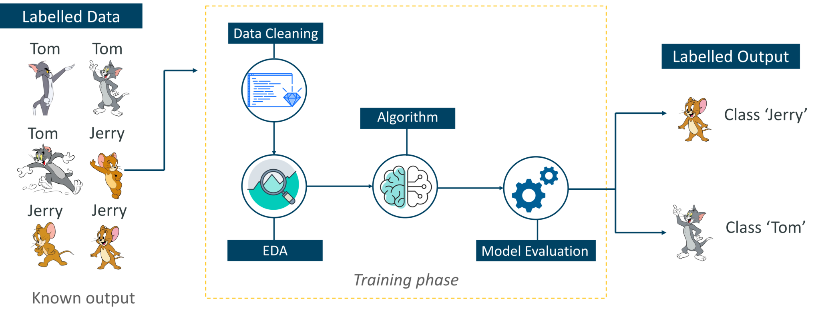
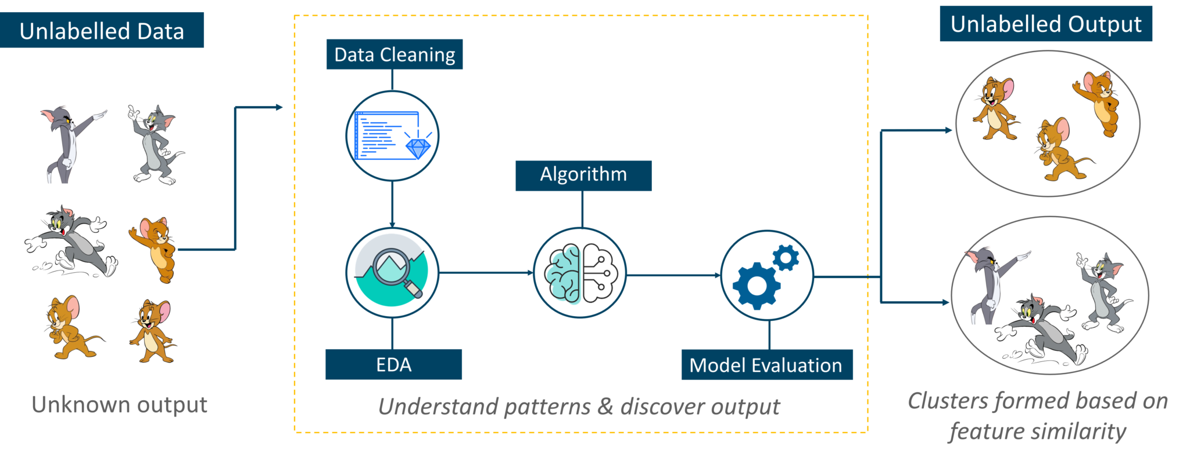
Machine Learning
1
Supervised Learning
Classification, regression
2
Unsupervised Learning
Clustering
3
Semi-supervised Learning
Google Photos
4
Reinforcement Learning
AlphaGo
Notes:
--
it was divided into supervised, unsupervised, semi-supervised and reinforcement branches
1- Supervised learning is regression and classification-based algorithms. It is a method in which we train the machine using labeled data in supervised learning. The chart above describes the labeled tom and jerry classification.
2- Unsupervised learning is clustering based algorithms. It is a method in which we train the machine without labeled data in unsupervised learning. In the second graph, tom and jerry are clustered.
3- Most semi-supervised learning algorithms are a combination of supervised and unsupervised learning algorithms. It allows us to train the machine using labeled and unlabeled data.
4- Reinforcement learning has a different algorithm than other methods. This learning method can observe the environment, perform its actions. After performing the action, if the action is correct, it will be rewarded, otherwise it will be punished. This process is repeated many times and it is aimed to develop a machine learning strategy.

Slide 4
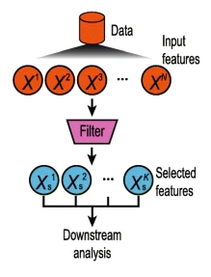
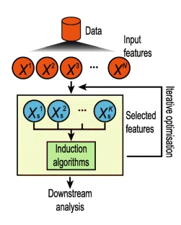
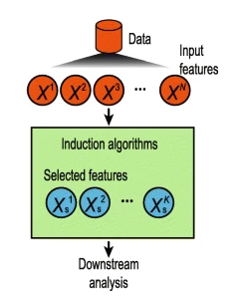
Feature Selection
Filter Methods
Wrapper Methods
Embedded Methods
Notes:
The purpose of feature selection methods is to model the most relevant features out of all the features in the data set, while removing the redundant ones from the model. When feature selection is applied, multicollinearity, over-fitting, training time, prediction time, and model complexity are reduced. In general, feature selection methods are divided into three categories: filter, wrapper and embedded.
Wrapper methods require a method to search the space of all possible subsets of features, by learning and evaluating a classifier with this subset of features and evaluating their quality. It follows a greedy search approach by evaluating all possible combinations of attributes against the evaluation criterion.
In embedded method, feature selection process is embedded in the learning or the model building phase.

Slide 5
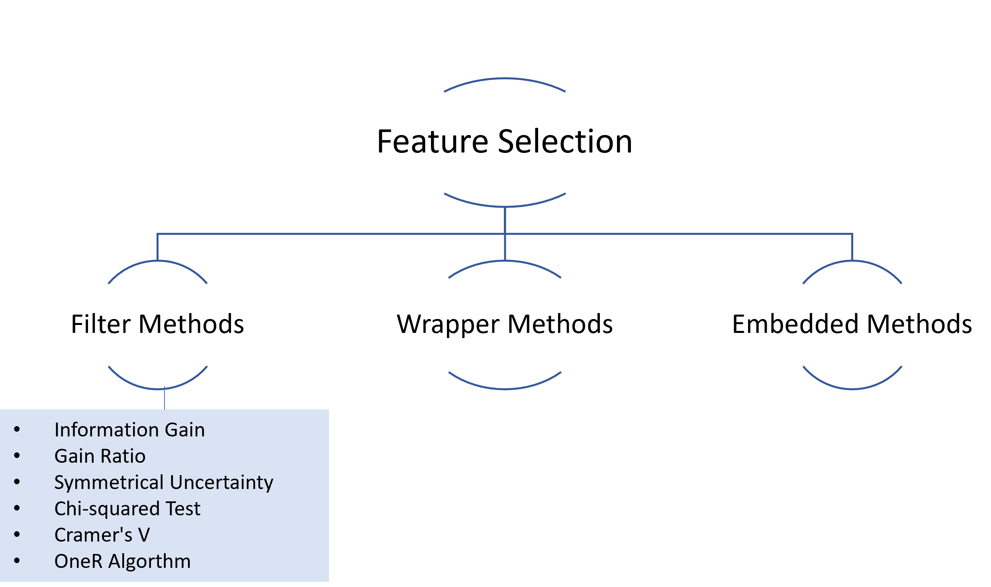
Notes:
Among the filter methods, methods using categorical input and categorical output are examined. These methods

Slide 6
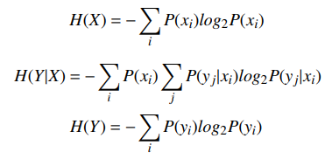
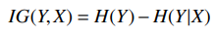
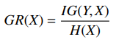
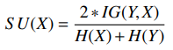
Filter Methods
1
Information Gain
2
Gain Ratio
3
Symmetrical Uncertainty
Notes:
1 Information Gain
Entropy-based searches have been carried out for feature ranking selection methods. Entropy is a measure of the uncertainty or disorder associated with a feature.
Formula 1 is the entropy formula calculated separately for each feature (X). Formula2 formula that calculates the entropy of the target variable (Y) each given category of feature (X). Formula3 is the formula that calculates the entropy of the target variable (Y). Information gain is measured by the reduction in entropy with or without the feature.
2 Gain Ratio
The gain ratio is calculated by dividing the information gain value by the entropy of the feature of interest. This calculation can be seen as a kind of normalization. Because the values convert to a range of 0 and 1.
3 Symmetrical Uncertainty
As the name suggests, this method provides a symmetrical normalization. It is obtained by dividing the information gain value by the sum of the feature and target variable. The gain ratio and symmetrical uncertainty are all the same except symmetrical

Slide 7
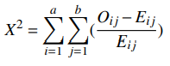
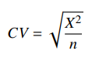
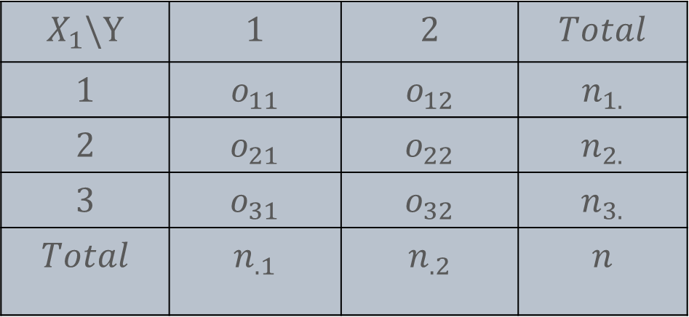
Filter Methods
4
Chi-square Test
$$X_{1}\backslash Y$$ | $$1$$ | $$2$$ | $$Total$$
$$1$$ | $$o_{11}$$ | $$o_{12}$$ | $$n_{1.}$$
$$2$$ | $$o_{21}$$ | $$o_{22}$$ | $$n_{2.}$$
$$3$$ | $$o_{31}$$ | $$o_{32}$$ | $$n_{3.}$$
$$Total$$ | $$n_{.1}$$ | $$n_{.2}$$ | $$n$$
5
Cramer’s V
6
OneR Algorithm
Notes:
4 Chi-squared Test
The feature selection method using chi-square statistics is used to test the relationship or independence of two categorical features. With each category of an feature, the observation value in each category of the target variable is determined. Calculates how much the value of each observation differs from the expected value of that observation.
5 Cramer’s V
Cramer’s V is a measure of association based on the Pearson chi-square statistic. Cramer’s V statistic is obtained by dividing the chi-square test statistical value by the sample size and taking the square root. Cramer’s V measures how strongly the feature and target variable are correlated.
6 OneR Algorthm
From this table we have obtained, the highest frequency of the categories of the target variable is accepted as the majority class. The number of observations with the given feature category but not the majority category is considered the error count. The sum of the errors of all categories of the feature gives the error of the features. Features with the lowest error are ranked.

Slide 8
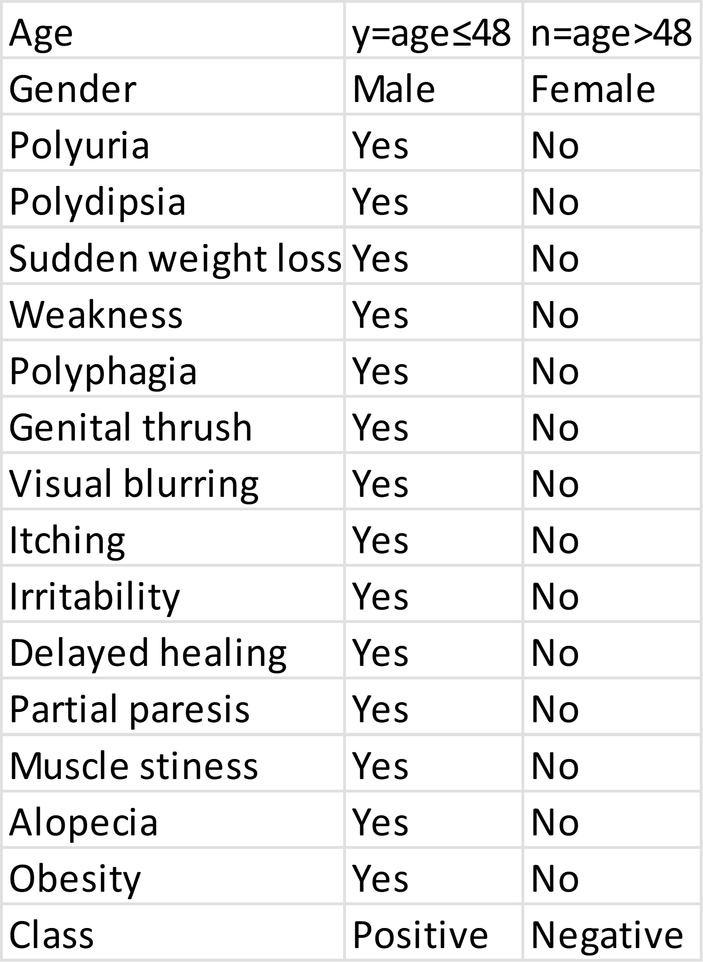
Data Summary
Filter Methods
Logistic Regression
Train
Cross Validation
Validation
Model Metrics
Notes:
The dataset used includes the signs and symptoms of the new diabetic or person who will have diabetes. Polyuria, Polydipsia, sudden weight loss, partial paresis, Gender, Alopecia...
Data set; It consists of 16 features, 1 target variable and 520 observations. In this study, the data set is divided into 500 observation train data and 20 observation validation data. In addition, cross validation was applied to the train dataset. Then, logistic regression was performed on the train dataset with filter methods. As a result, model metrics of validation and cross validation were calculated.

Slide 9
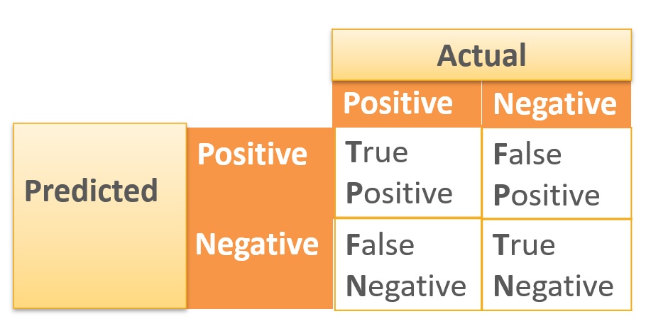
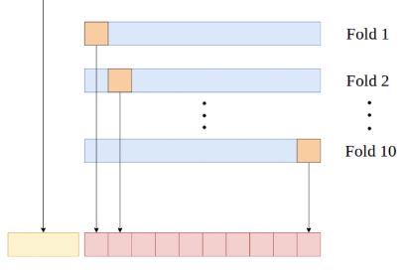
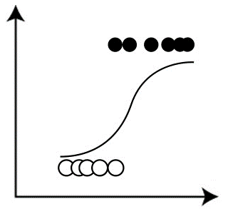
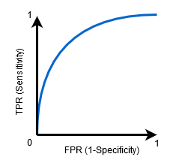
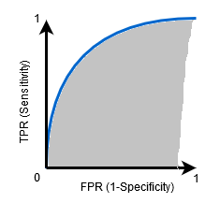
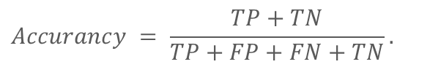
Cross Validation
Logistic Regression
Model Metrics
Lojistic regression is used only for two-class problems. It belongs to the family of "probabilistic classifiers" and uses the maximum likelihood estimation to evaluate the class probability.
$$Accurancy = \frac{TP+TN}{TP+FP+FN+TN}$$
ROC
AUC
Notes:
After separating the dataset into train and validation dataset, 10-fold cross validation was used on the train dataset. The 10-fold cross validation divides the train dataset into 10 equal parts and uses each part as test data in turn. The average of the accuracies obtained here gives the reciprocal cross validation accuracy.
From the model metrics obtained from the cross-validation matrix, The sensitivity of a screening test is typically the ability of a screening test to detect a true positive, based on its true positive rate, and reflect the ability of a test to accurately identify all people with the disease. The specificity of a test, typically specificity, is the ability of a screening test to detect a true negative, based on its true negative rate, accurately identifying people who do not have a condition. The accuracy of a test is its ability to accurately distinguish between sick and healthy cases.
Lojistic regression is used only for two-class problems. It belongs to the family of "probabilistic classifiers" and uses the maximum likelihood estimation to evaluate the class probability.

Slide 10
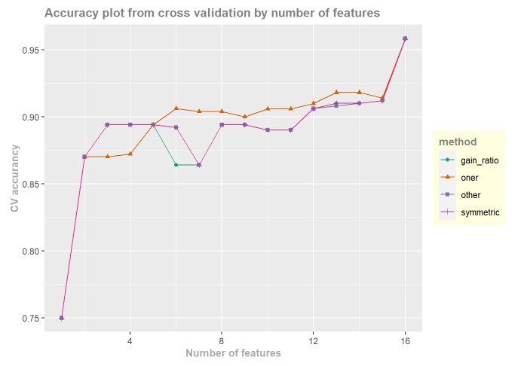
Why Six Features?
Notes:
For the optimal model, models with 16 features were examined from the model with 1 feature. This chart also shows validation accuracies according to the number of features.
All models of filter methods are equally accurate when the number of features is 1. Models with one feature count all chose the same feature; Polyuria.
The first differentiation came from the oneR algorithm when the model had 3 features.
When the model has 5 attributes, the features in all models are the same.
While the accuracy of the OneR algorithm increased when there were 6 features in the model, the accuracy of the gain ratio decreased, and they differed from other methods. and the oneR algorithm exceeded 90% accuracy.
90% accuracy was achieved by using only 6 features out of 16 features. Then the accuracy values ​​are less than 90% until there are 12 features. For this reason, it was thought that the optimal number of features should be 6.
When we look at the graph, it has been observed that the models work differently when the filter methods have the same number of features compared to the total number of features, and the models are the same when the number of features is low or high.

Slide 11
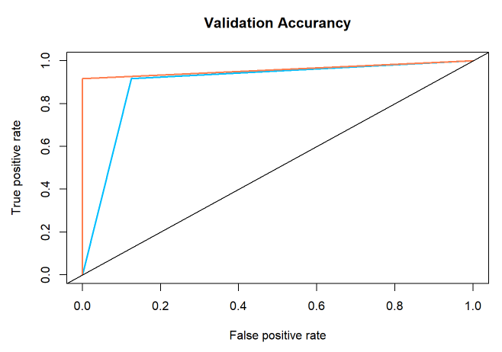
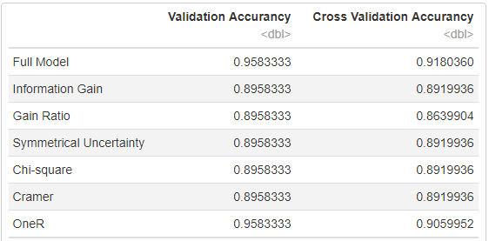
Results
Notes:
As a result, six filter methods were applied for this dataset. While 5 of them have the same validation accuracy, the OneR algorithm is more than the others with about 95% accuracy. Even The validation accuracy obtained with the OneR algorithm, and the validation accuracy obtained from the full model were the same. In other words, the accuracy of the model created with 6 features and the model created with 16 features are the same.

Slide 12

Conclusions
Text
3-12t
Notes:
Grafiğe baktığımızda, filter yöntemlerin toplam öznitelik sayısına göre öznitelik sayısı düşük ya da fazla olduğu durumlarda modellerin aynı, orta seviyede olduğunda modellerin farklı çalıştığı gözlemlenmiştir. Simule. #fs araştırmacıya kalmış.
6 özniteliği yaz ve diyabet erken teşhis için önemli old söyle
Logistik katlar
Optimal modelin OneR algoritmasıyla filtrelenen logistik regresyon modeli olduğuna karar verilmiştir. Bu durumda Polyuria, Polydipsia , Sudden.weight.loss, partial.paresis, Gender, Alopecia değişkenleri erken diyabet teşhisinde etkili belirtilerdir.

Slide 13

References
Bommert, A., Sun, X., Bischl, B., Rahnenführer, J., & Lang, M. (2020). Benchmark for filter methods for feature selection in high-dimensional classification data. Computational Statistics & Data Analysis, 143, 106839.
Huang, S. H. (2015). Supervised feature selection: A tutorial. Artif. Intell. Res., 4(2), 22–37.
Kira, K., & Rendell, L. A. (1992). A practical approach to feature selection. In Machine learning proceedings 1992, 249–256.
Kumar, V., & Minz, S. (2014). Feature selection: a literature review. SmartCR, 4(3), 211–229.
Ladha, L., & Deepa, T. (2011). Feature selection methods and algorithms. International journal on computer science and engineering, 3(5), 1787–1797.
Ni, W. (2012). A review and comparative study on univariate feature selection techniques.
Saeys, Y., Inza, I., & Larranaga, P. (2007). A review of feature selection techniques in bioinformatics. bioinformatics, 23(19), 2507–2517.
Singh, A., & Jain, A. (2019). Adaptive credit card fraud detection techniques based on feature selection method. In Advances in computer communication and computational sciences, 167–178.

Slide 14

Questions?

